Slide 1


Infosys Springboard 5.0
EVENT MANAGEMENT SYSTEM
TEAM MEMBERS
Abhisha Hedge
Piyush Raj
Ashish Jha
Thejasvi
Team No: 1
Mentor : A. Abhinaya

Slide 2

PROBLEM STATEMENT
Event planning involves complex tasks like scheduling, ticket booking, and venue coordination, often causing inefficiencies and errors with traditional methods. Manual processes lead to delays and poor user experiences. There is a growing demand for streamlined workflows and real-time updates. An automated solution is needed for seamless coordination, accurate scheduling, and smooth booking.

Slide 3





ABSTRACT
Provides a customer portal for event browsing, booking, payments, and viewing bookings.
Includes an admin portal for managing events, customer details, and appointments.
Features a notification system to keep customers updated on event changes.
Simplifies event-related processes for both customers and administrators.
Ensures efficient and organized event management.

Slide 4

PROJECT
ROADMAP

Slide 5
TECHNOLOGY STACK
● Backend : Flask, SQLAlchemy
●Frontend : HTML, CSS, JavaScript, Bootstrap
● Database : MySQL
● Tools : Git, VS Code, Pycharm
● Hosting : Flask Local Server

Slide 6





USE
CASE
DIAGRAM
Register
Login
Add event
Managing
functions
Book Tickets
ADMIN
USER
Secure Payment
Receive Notification

Slide 7
CHALLENGES AND SOLUTIONS
1.
Challenge: Handling overlapping event
schedules effectively.
Challenge: Integrating real-time notifications
for users.
Solution:
Simple algorithm to prevent event overlap.
2.
Solution:
Simulate alerts or messages within website.
3.
Challenge: Ensuring secure authentication
and payment processing.
Solution:
Secure username login for venue booking.
Challenge: Send customizable notifications to particular user.
4.
Solution:
Customizable notifications with user selection.
Challenge: Ability to set appointment
5.
Solution:
Static appointment scheduling with form inputs.

Slide 8
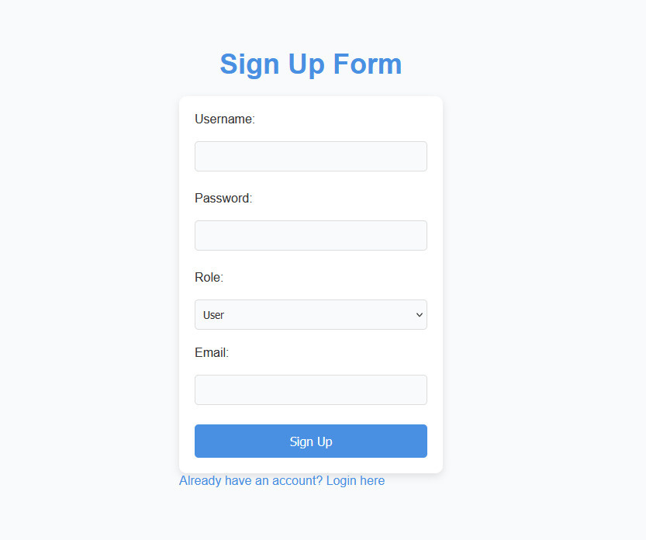

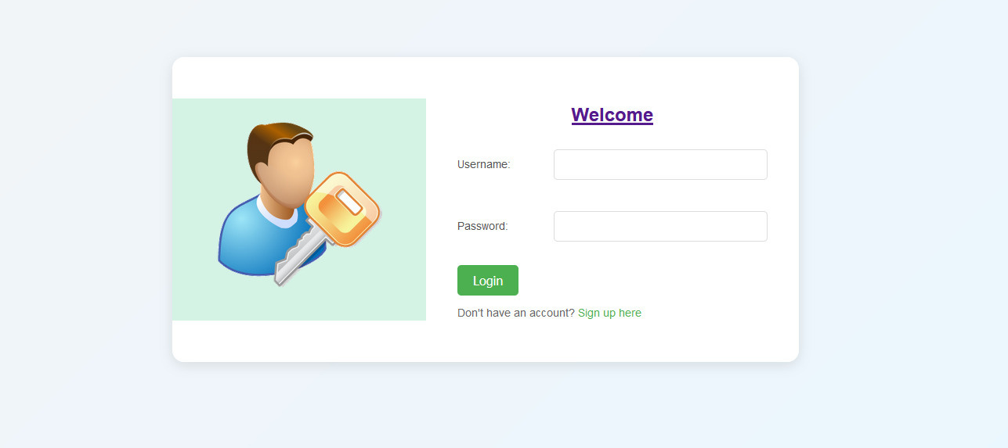
CUSTOMER SIDE
LOGIN AND SIGNUP

Slide 9
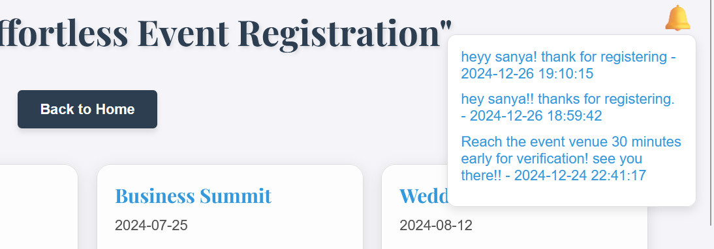
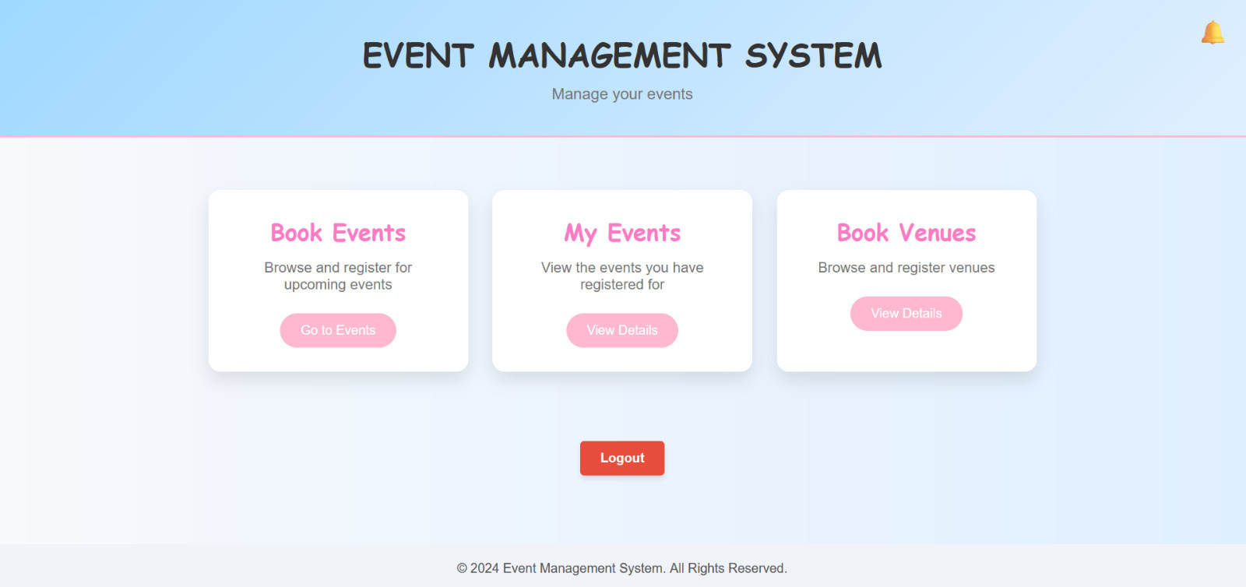
USER DASHBOARD
NOTIFICATION

Slide 10
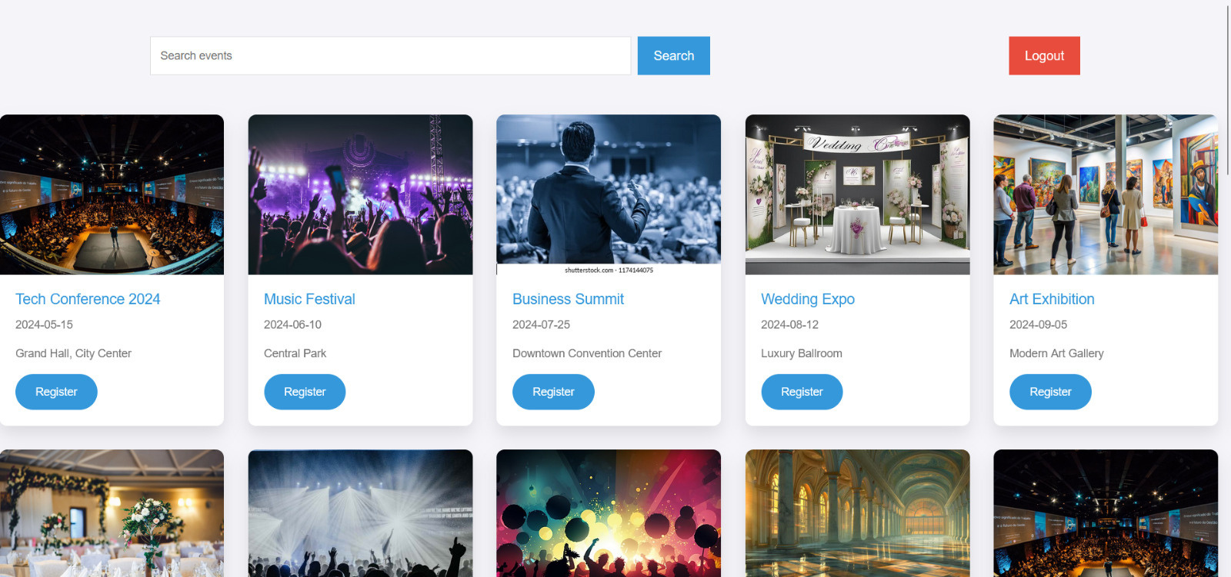
BOOKINGS

Slide 11
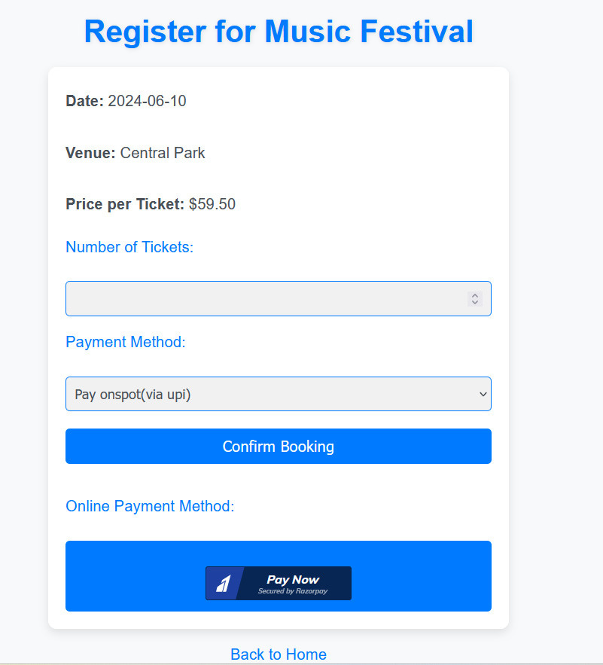
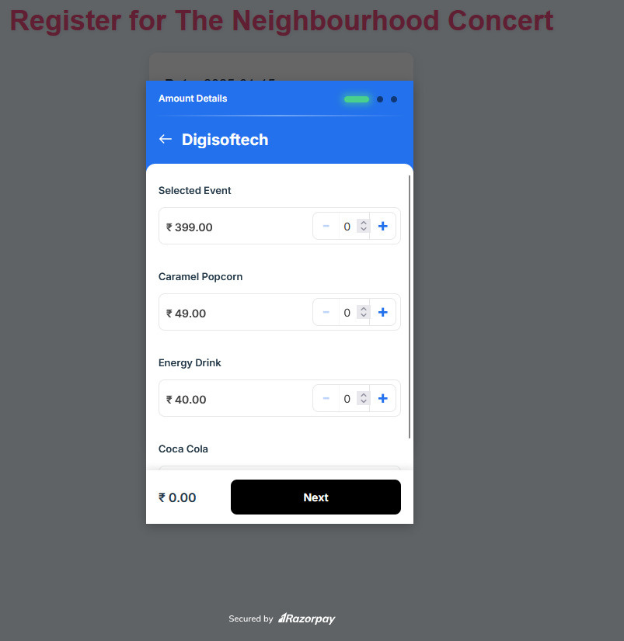
PAYMENT

Slide 12
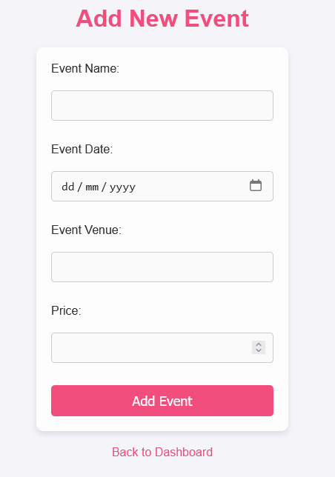
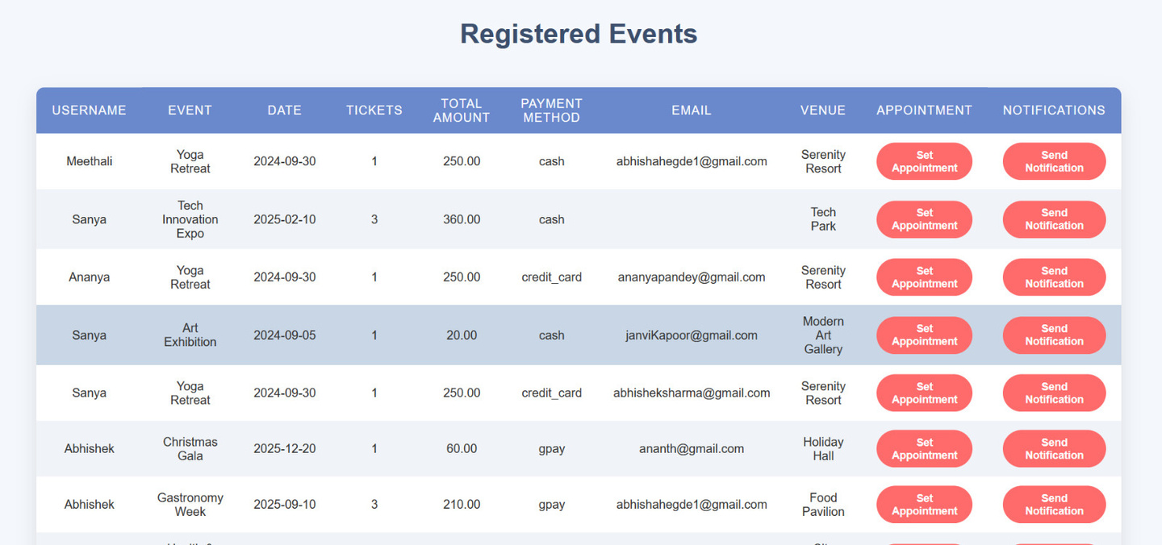
ADMIN SIDE
VIEW REGISTRED EVENTS

Slide 13
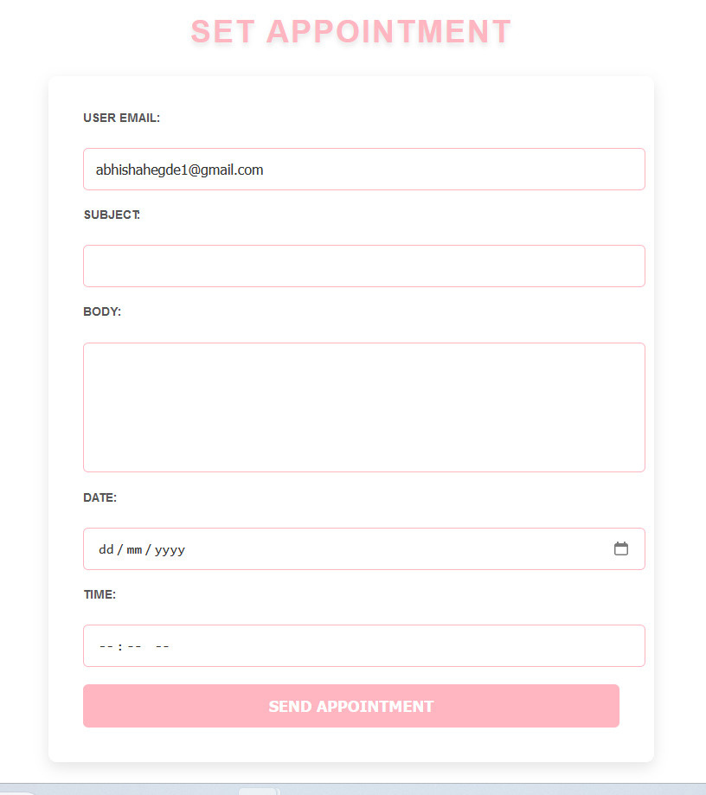
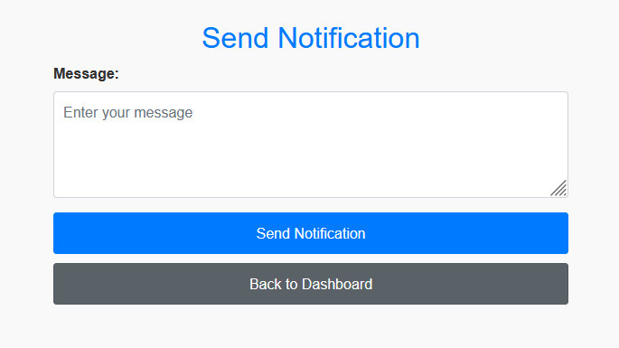
SET APPOINTMENT &
SEND NOTIFICATION

Slide 14

FUTURE SCOPE
Integration with third-party calendars (e.g., Google Calendar).
Enhancing accessibility through a mobile application.
Incorporate support for multilingual language into the interface.

Slide 15
CONCLUSION
The Event Management System streamlines event creation, ticket booking, and venue coordination, ensuring efficiency and accuracy. It offers a seamless, user-friendly experience, enhancing both organizer and attendee satisfaction.

Slide 16
THANK YOU !

